Slide 1
Comp 490/L
Senior Design Project
Fall 2023
Final Project Presentation
Team: ChatJTDAN
Team members: Aya, Nora, Joe, Mubeen, Tigran, and Dylan
Team Leader: Aya Samaha

Slide 2
Agenda
Project Overview
Problem Definition
Application Screenshots
Software Overview
Sample Code Snippets
App Demo
Progress and Future work
Questions

Slide 3
Project Overview
Creating a phone app Android to be specific that’s accessible for everyone. That is designed to help you achieve your goals. There is no targeted audience; it's available to all consumers. Whether you're a tech-savvy enthusiast, a busy professional, a student trying to manage their time , or anyone in between, our product is tailor-made to enhance your lifestyle. We believe in inclusivity and accessibility for all, which is why we've made sure that everyone can succeed using our app “Goal!” We made sure that our app could be used in a variety of ways for example:
Students struggle sometimes with time management and with getting all their assignments on time. Organizing a healthy schedule on how to get all their work done on time is crucial and I can stand by that since I’m a student myself. Thus, The intended use in this case would be that “Goal!” keeps up with the list of tasks you assign to it by sending reminders of when a separate task is due and as well keeping track of the progress made daily depending on how many tasks have been completed that day. This is displayed via a statistical graph in the app.
Doctors as well have a lot on their plate. We made “Goal!” an app that has ease of use which means making it user-friendly a top priority of ours. You don't need to be tech savvy to enjoy our product. It’s intuitive and straightforward to anyone now doctors could simply open the app and add in when their next appointment with their patient is going to be. Just by setting a time and date for when the event is taking place.

Slide 4
Problem Definition
Quantifying one’s long-term goals and accomplishing them is a problem for most people. Without proper, organized planning, goals easily turn in to “I could’ve done this.. I could’ve done that.”
Our application sets out to solve this problem by following this procedure:

Slide 5
Problem Definition
1. Create Long-Term Goals
The Users will be able to create long-term goals attached to a date which they would like to have it completed by.

Slide 6
Problem Definition
2. Subdivide goals into smaller goals
This will allow the user to break down a large task into smaller ones which they will likely be more able to complete in a shorter amount of time.And since every smaller goal will be in order, each goal will lead in to the next.
After all these smaller goals are complete the long-term goal will also be complete.

Slide 7
Problem Definition
3. Statistics
The application will also track the rates of completion so the user will have useful information in order to be able to quantify what they did or didn’t get done. This will help the users know whether they’re improving on completing their goals.. Or not.

Slide 8
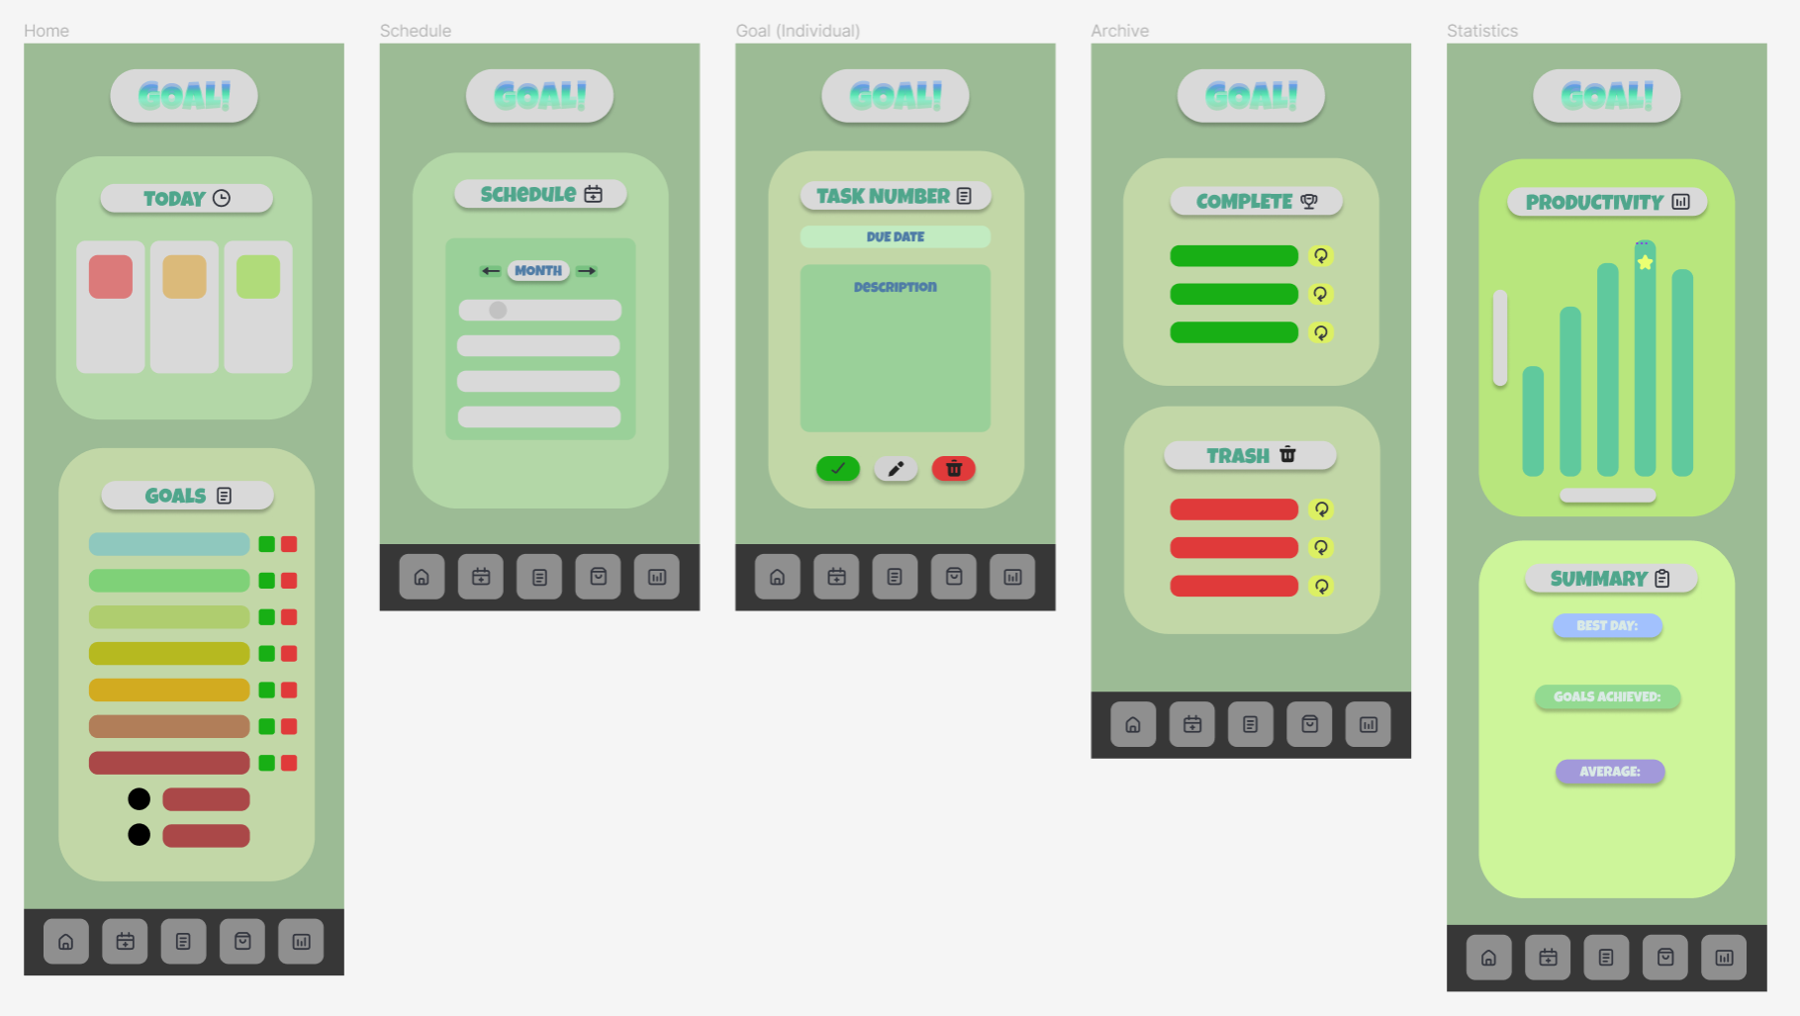
Application Wireframe
Five pages:
Home
Schedule
Goal (Individual)
Archive
Statistics

Slide 9
Wireframe Breakdown
Home:
Yesterday, today, and tomorrow displayed at the top - immediate reminder of upcoming and past due dates for set goals
Listing of all goals and subgoals; to the right of each are color-coded “complete” and “delete” buttons
Schedule:
Calendar displaying a full month – current date is grayed out and dates may be selected to view pop-up of tasks due on selected date
Arrow keys can be tapped to move back and forth between months
Goal (Individual):
Task number in header, followed by due date and then description
“Complete”, “edit”, and “delete” buttons below
Archive:
Two boxes for completed and deleted goals, respectively
Every goal listed has a restoration button to its right
Restoring a goal will cause it to display on the home page again
Statistics:
Bar graph displaying goals completed each day for the past week
Can be adjusted to week/month or month/year
Best day(s) are marked
Summary of the week’s/month’s/year’s progress
Most productive day/week/month, total goals achieved, and average
Other:
Button layout at the bottom of every page - navigation bar
Home, schedule, task, archive, and statistics buttons

Slide 10
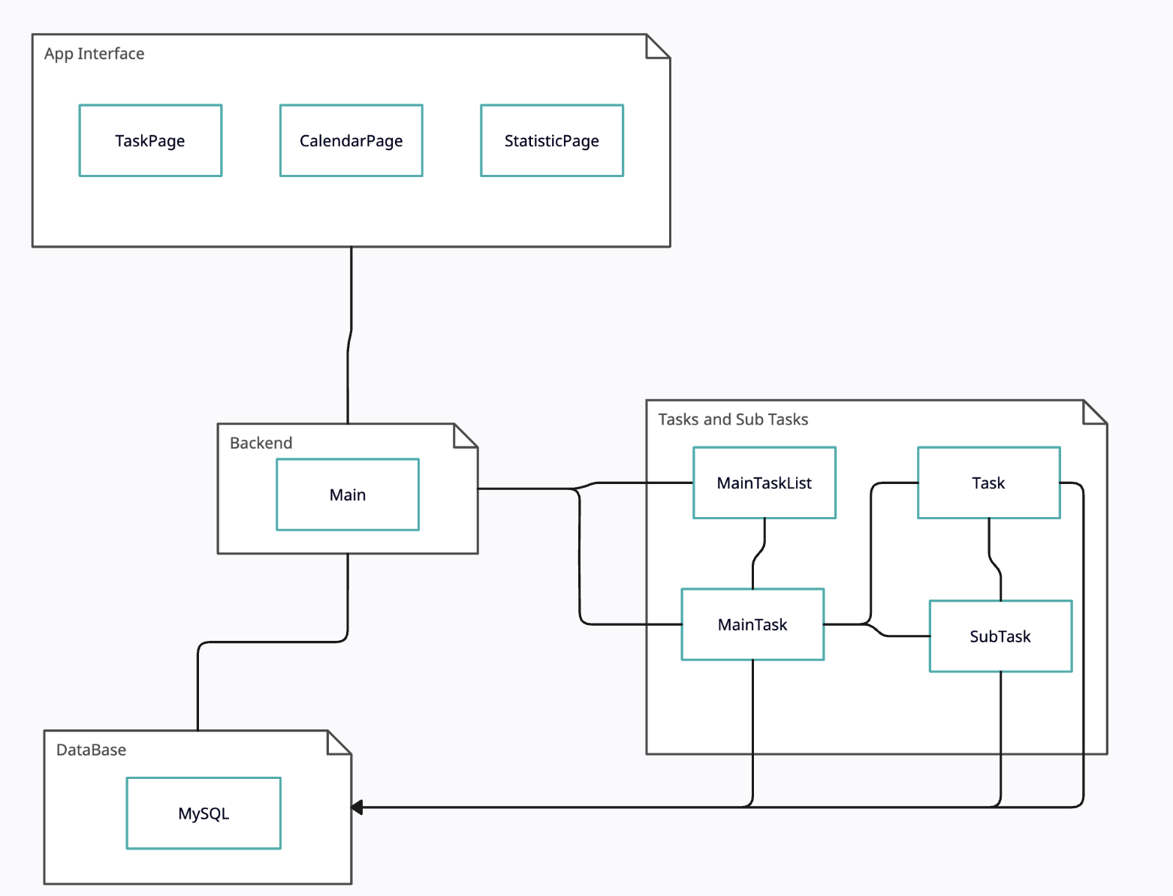
Software Overview Diagram and Explanation
Main Class acts as hub
Controls data access, and keeps track of tasks
If any of the Interface pages want data from database, they go through the main class
Abstraction was important to us
Tasks can directly change the data in the database. This was done to streamline the process.
While this does mean higher coupling it seems to be a faster way of operating and organizing data

Slide 11
Code Snippets
(Saved for COMP 491)

Slide 12
App Demo
(Saved for COMP 491)

Slide 13
Progress and Future Work
Successfully conceived and designed the “Goal” app targeting a diverse user base without specific audience segmentation
Documentation
Will have team meetings during the winter break as well as coding majority of our project throughout the duration of the break.
UI improvements
Expansion to other platforms
Comply with relevant privacy regulations and standards.

Slide 14

Questions?

